Slide 1
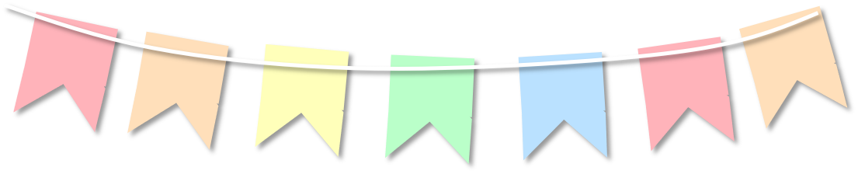
Topic: Circles in context EQ: How do I solve worded questions involving circles?
circles

Slide 2
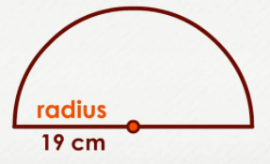
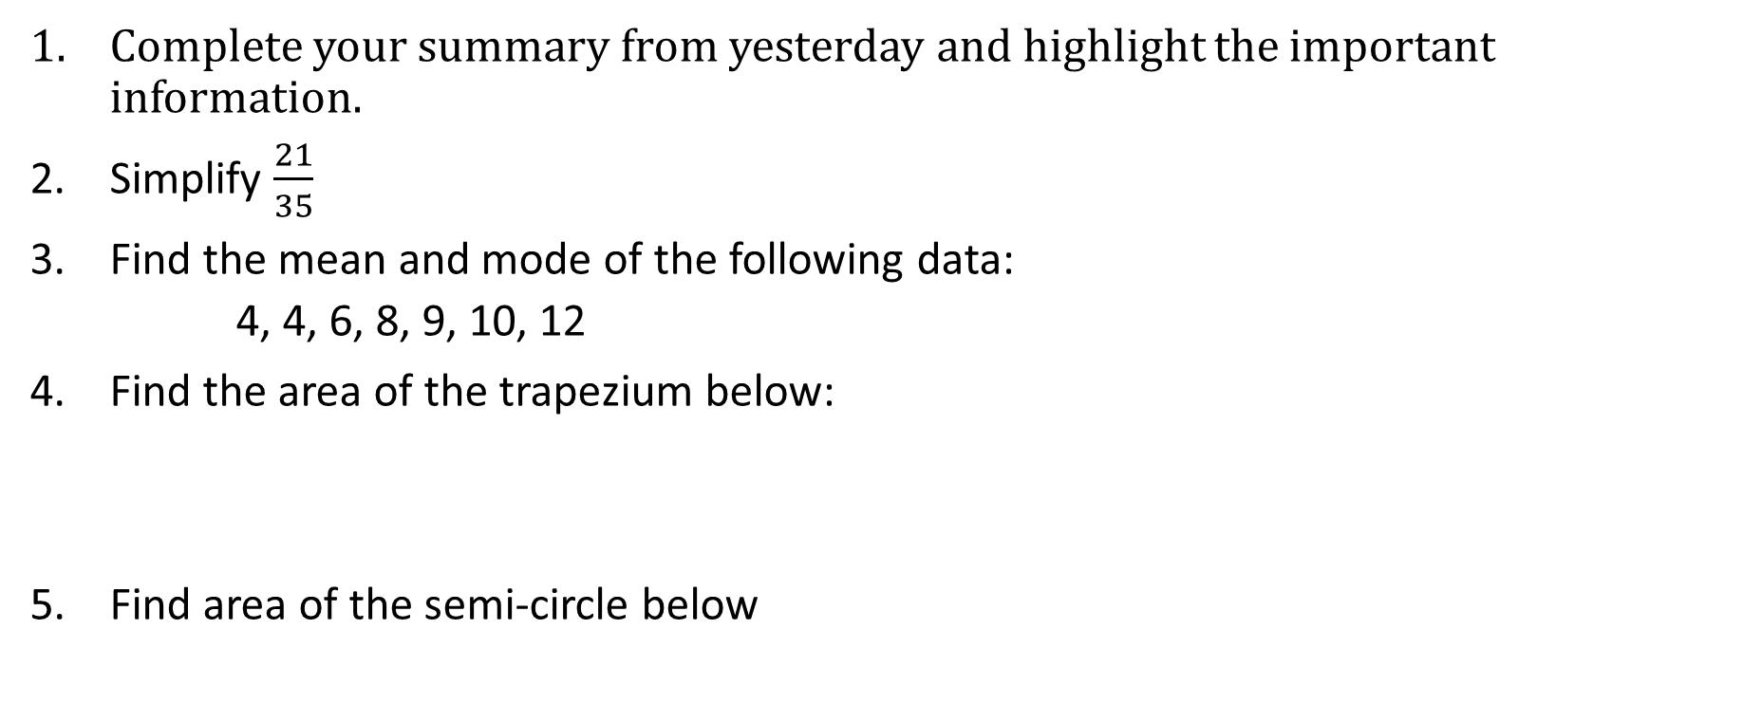
Have a go at these questions:
Topic: Circles in context EQ: How do I solve worded questions involving circles?
Complete your summary from yesterday and highlight the important information.
Simplify $\frac{21}{35}$
Find the mean and mode of the following data:
4, 4, 6, 8, 9, 10, 12
Find the area of the trapezium below:
Find area of the semi-circle below
5 cm
6 cm
11 cm

Slide 3
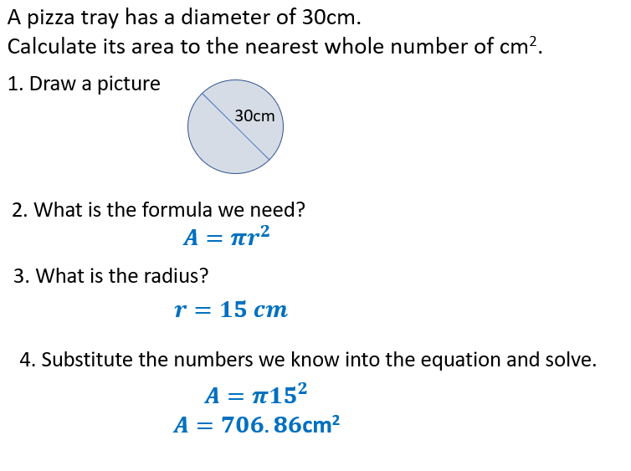
Topic: Circles in Context
EQ: How do I solve worded questions involving circles?
How do I find the area of circle in context?

Slide 4


Slide 5



Practice
The floor of a round hut has a radius of 2 yards. What is the floor's diameter?
A merry-go-round has a circular platform with a radius of 1 meter. What is the platform's area?
After stepping into a room with unusual lighting, Ava's pupil has a radius of 4 millimeters. What is the pupil's area?
A dog is leashed to a point in the centre of a large yard, so the area the dog is able to explore is circular. The leash is 20 meters long. What is the area of the region the dog is able to explore?
4 Yards
3.14$m^{2}$
50.27${mm}^{2}$
314.16$m^{2}$

Slide 6
Practice 2
A tree trunk is cut to reveal a circular cross-section of radius 60cm. Is the area of the cross-section more than 1m² and, if so, by how much?
A circular oil slick has a diameter of 1km. The newspaper reported an area of more than 1km². Is the newspaper correct?
Which has the largest area, a circle of radius 5m, a semicircle of radius 7m, or a quadrant of radius 9m?
Two circular plates have radii 12cm and 13cm. Find the difference in their area correct to 2 decimal places.

Slide 7
Practice 2
A tree trunk is cut to reveal a circular cross-section of radius 60cm. Is the area of the cross-section more than 1m² and, if so, by how much? Yes, by 1310cm²
A circular oil slick has a diameter of 1km. The newspaper reported an area of more than 1km². Is the newspaper correct? No (A=0.79km²)
Which has the largest area, a circle of radius 5m, a semicircle of radius 7m, or a quadrant of radius 9m? Circle radius 5m
Two circular plates have radii 12cm and 13cm. Find the difference in their area correct to 2 decimal places. 78.54cm²

Slide 8
What Questions
do you have??

